Slide 1
CSA1522-CLOUD COMPUTING
A Comparative Study of IaaS, PaaS, and SaaS
for an Educational Institution
Presented by ARAVIND KUMAR.S (192524210)
MAGESH.S (192525002)
BRIJESH.T (192521391)

Slide 2


Objective & Introduction
Objective
Introduction
Understand cloud computing service models
Compare IaaS, PaaS, and SaaS
Learn their applications in educational institutions
Identify the best cloud service for different academic needs
Cloud computing provides computing resources such as servers, storage, software, and applications over the Internet. It helps educational institutions reduce costs, improve accessibility, and support online learning.
3
Service Models Compared

Slide 3

IaaS
Infrastructure as a Service
IaaS provides virtualized computing resources such as servers, storage, and networking over the Internet.
Examples
AWS EC2
Microsoft Azure Virtual Machines
Google Compute Engine
Features
Virtual Machines
Cloud Storage
Networking
High Scalability
Pay-as-you-use pricing
Educational Use
Universities host websites, databases, and Learning Management Systems (LMS).

Slide 4

PaaS
Platform as a Service
PaaS provides a complete development platform for building, testing, and deploying applications.
Examples
Google App Engine
Heroku
Azure App Service
Features
Ready development environment
Database support
Automatic updates
Easy deployment
Educational Use
Students and faculty develop educational websites and mobile applications.

Slide 5

SaaS
Software as a Service
SaaS delivers ready-to-use software applications through the Internet.
Examples
Google Classroom
Microsoft 365
Gmail
Zoom
Features
No installation required
Accessible from anywhere
Automatic updates
Subscription-based service
Educational Use
Online classes, assignment submission, video meetings, and collaboration.

Slide 6
Comparison & Architecture
Feature | IaaS | PaaS | SaaS
Provides | Infrastructure | Platform | Software
User Manages | OS & Apps | Apps | Only Usage
Technical Skill | High | Medium | Low
Cost | High | Medium | Low
Best For | Server Hosting | App Development | Online Learning
Cloud Service Stack
Users
SaaS (Software)
PaaS (Platform)
IaaS (Infrastructure)
Physical Hardware

Slide 7






Real-World Use Case & Benefits
Educational Institution Use Case
Benefits
Hosts college website and LMS.
IaaS
Cost Reduction
Easy Accessibility
Students develop cloud-based applications.
PaaS
Teachers conduct online classes; students submit assignments; faculty collaborate using cloud apps.
Data Security
Scalability
SaaS
Better Collaboration
Remote Learning Support

Slide 8

Conclusion
Cloud computing plays a vital role in modern education. IaaS provides infrastructure, PaaS supports application development, and SaaS delivers ready-to-use software. Educational institutions can improve learning, collaboration, and resource management by choosing the right cloud service model.
Key Takeaways
Thank You
IaaS → Infrastructure
PaaS → Development Platform
SaaS → Ready-to-use Software
Improves flexibility, reduces cost, and supports digital education.

Slide 9
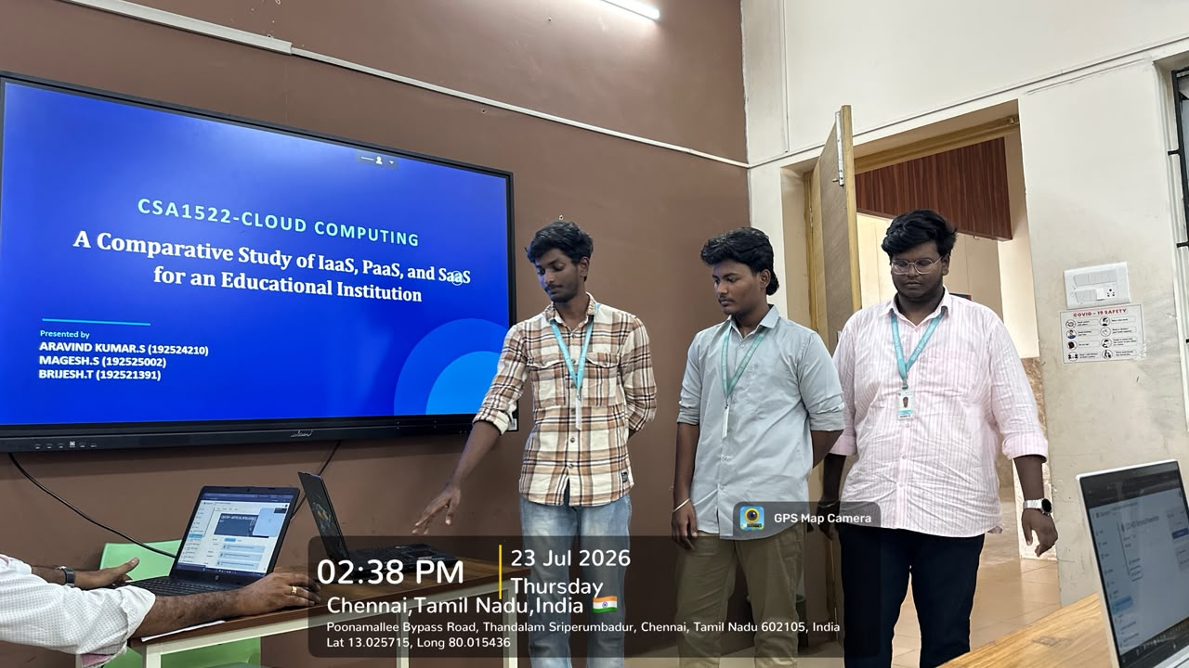

Slide 10
